Slide 1
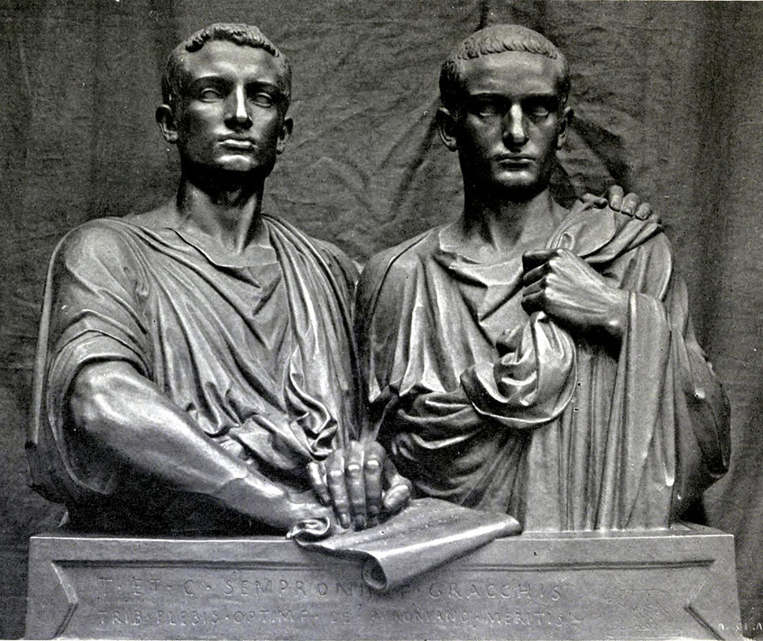
Essay Writing
GOAL/S: Outline Essay writing structures
Week 5, Lesson 2

Slide 2
Class Discussion
What do you already know about essay writing structures?

Slide 3
Today’s Lesson
Understanding Essay Structure/Function
Thesis Statements Vs. Topic Sentences
Body Paragraphs
Introductions and Conclusions

Slide 4
Essay Structure
An essay is a piece of writing that presents an argument or discusses a particular topic in a structured format. Its purpose is to inform, persuade, or entertain the reader while conveying the author's perspective or analysis on the subject matter.
Introduction: This section provides background information on the topic and presents the thesis statement, which outlines the main argument or purpose of the essay.
Body Paragraphs: These paragraphs develop and support the thesis statement by presenting evidence, examples, and analysis. Each body paragraph focuses on a specific aspect or sub-argument related to the main topic.
Conclusion: The conclusion summarizes the main points of the essay and restates the thesis statement in light of the evidence presented in the body paragraphs. It may also offer insights or suggestions for further consideration.
Notes:
Who is the author?

Slide 5
Introduction
Function: Introduces the topic to the reader and provides context for the argument. It also grabs the reader's attention and sets the tone for the essay.
It must include the following:
Thesis Statement – What is the essay arguing? (NOT WHAT IS IT ABOUT)
Background information – A brief overview of key people, events, ideas
Essay Map – A brief overview of what each body paragraph will discuss

Slide 6
Introduction – Example A
Thesis Statement: This essay will argue that Tiberius and Gaius Gracchus had some impact on ancient Rome during 133–121 BCE. Background information: Tiberius and Gaius Gracchus were brothers who lived in ancient Rome. They did some stuff in the period of 133–121 BCE. Essay Map: The first body paragraph will talk about Tiberius Gracchus, and the second body paragraph will talk about Gaius Gracchus. That's pretty much it.

Slide 7
Introduction – Example B
Thesis Statement: The dynamic duo of Tiberius and Gaius Gracchus wielded significant influence over the socio-political landscape of ancient Rome during the transformative period of 133–121 BCE, reshaping the contours of power and igniting debates that reverberated throughout Roman society for generations to come. Background information: Tiberius and Gaius Gracchus emerged as prominent figures during a time of profound social and economic upheaval in the Roman Republic. Born into a noble patrician family, they were driven by a sense of duty and a fervent desire to address the deep-seated inequalities plaguing Roman society. The period of 133–121 BCE was marked by growing discontent among the plebeian class, exacerbated by rampant corruption, land consolidation, and the widening gap between the wealthy elite and the impoverished masses. Against this backdrop, the Gracchi brothers embarked on a bold and controversial crusade to enact sweeping reforms aimed at empowering the disenfranchised and challenging the entrenched privileges of the aristocracy. Essay Map: The first body paragraph will delve into the transformative impact of Tiberius Gracchus, focusing on his groundbreaking land reforms and their implications for the distribution of wealth and power within Roman society. The second body paragraph will explore the contributions of Gaius Gracchus, highlighting his innovative political initiatives aimed at expanding citizenship rights, advocating for social welfare programs, and amplifying the voices of the plebeian class in the corridors of power. Through a nuanced analysis of the Gracchi brothers' distinct yet interconnected efforts, this essay will illuminate the ways in which they navigated the turbulent currents of Roman politics, leaving an indelible mark on the socio-political landscape of ancient Rome during this pivotal period.

Slide 8
Body Paragraphs
Function: Each body paragraph presents a separate argument or piece of evidence to support the thesis statement. They provide depth and detail to the essay's main argument.
It must include the following:
Topic Sentence– What is the paragraph arguing? (NOT WHAT IS IT ABOUT)
Explanation/Evidence– An overview of key people, events, ideas related to topic sentence, and examples/evidence that support your claims
Link– Summary sentence

Slide 9
Body Paragraphs – Example A
Topic Sentence: Tiberius Gracchus was a guy who did some things during the period of 133–121 BCE.
Explanation/Evidence:
He came from a fancy family and decided he wanted to help the poor people. So, he made a law that said rich people can't have too much land, and they have to give some to poor people. But then some rich people got mad and killed him.
Link:
So, Tiberius Gracchus tried to help, but it didn't work out too well for him.

Slide 10
Body Paragraphs – Example B
Topic Sentence:
Tiberius and Gaius Gracchus significantly reshaped the socio-political landscape of ancient Rome through their bold reforms and advocacy for the rights of the plebeian class during the tumultuous period of 133–121 BCE.
Explanation/Evidence:
Tiberius Gracchus, a tribune of the plebs, initiated land reforms known as the Lex Sempronia Agraria, which aimed to address the unequal distribution of land by limiting the amount of land an individual could own and redistributing excess land to the landless poor. Additionally, Gaius Gracchus expanded upon his brother's efforts by introducing legislation to provide subsidized grain for the urban poor and advocating for the extension of Roman citizenship to allied communities.
Link:
Together, the Gracchi brothers' actions challenged the dominance of the senatorial elite, stirred social unrest, and laid the groundwork for future socio-political movements in ancient Rome, leaving a lasting impact on the trajectory of the Roman Republic.

Slide 11
Topic Sentence Vs. Thesis Statements
Thesis Statement (Introduction Paragraph):
Purpose: The thesis statement serves as the main argument or central claim of the entire essay. It provides a clear and concise overview of the essay's purpose and the stance the author will take on the topic.
Placement: Typically found at the end of the introduction paragraph, though it can sometimes be positioned elsewhere depending on the essay's structure.
Scope: The thesis statement encapsulates the entirety of the essay, outlining what the reader can expect to find in the subsequent body paragraphs.
Example: "In this essay, I will argue that Tiberius and Gaius Gracchus significantly shaped the period of 133–121 BCE in ancient Rome through their political reforms and advocacy for social justice, fundamentally altering the socio-political landscape of the Roman Republic."
Topic Sentence (Body Paragraph):
Purpose: The topic sentence serves as a mini-thesis for the individual paragraph, outlining the main point or argument that will be discussed in that specific paragraph.
Placement: Typically found at the beginning of each body paragraph to provide a clear focus and direction for the reader.
Scope: The topic sentence sets the tone and direction for the paragraph, guiding the reader through the specific argument or evidence that will be presented.
Example: "One of the key contributions of Tiberius Gracchus to the socio-political landscape of ancient Rome was his initiation of land reforms aimed at addressing the unequal distribution of land among the populace."
Notes:
In summary, while the thesis statement outlines the overarching argument of the entire essay, the topic sentence focuses on a specific point or argument within a single paragraph, guiding the reader through the essay's structure and content.

Slide 12
Conclusion
Function: Summarizes the main points of the essay and reinforces the significance of the argument presented in the thesis statement.
SAMPLE A: In conclusion, Tiberius and Gaius Gracchus did some stuff during the period of 133–121 BCE. They tried to help poor people and change things, but it didn't really work out. Overall, they did some things, but it's hard to say if they really made a big difference in ancient Rome.
SAMPLE B: the legacy of Tiberius and Gaius Gracchus reverberates throughout the history of Ancient Rome, casting a long shadow over the socio-political landscape of the tumultuous period of 133–121 BCE. Through their bold reforms and unwavering advocacy for the rights of the plebeian class, the Gracchi brothers challenged the entrenched power structures of the Roman Republic, laying bare the stark inequalities that plagued society. While their efforts ultimately met with resistance and tragedy, their courageous actions paved the way for future reform movements and ignited a spark of social consciousness that would endure for centuries to come. Indeed, the enduring impact of the Gracchi brothers serves as a poignant reminder of the enduring struggle for justice and equality in the pages of history.

Slide 13
ACTIVITY – Marking Essays
In pairs, read and discuss the essay samples provided
Using the marking key, give each essay a mark
Provide them with feedback
See if you can find the following:
Thesis Statement
Background Info
Essay Map
Topic Sentences
Evidence/Examples

